Slide 1


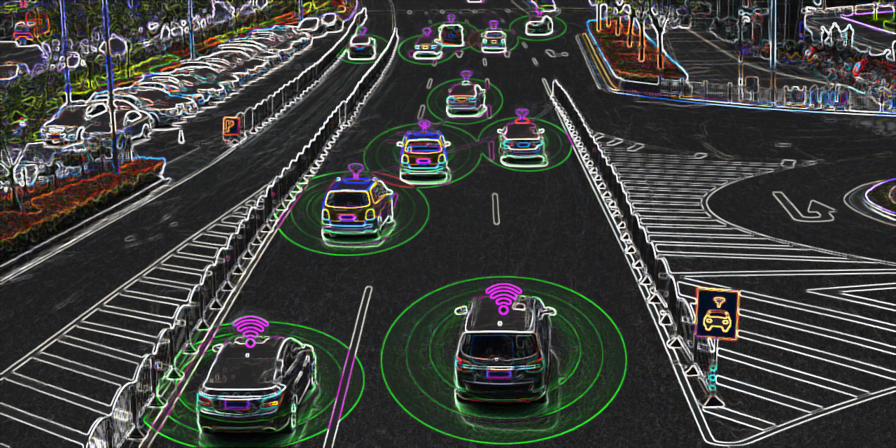
TTP 220 Policy Analysis
Autonomous Vehicles: A Meta-Analysis on all US State Legislation (2012-2019)
Author: Michael Gaunt

Slide 2

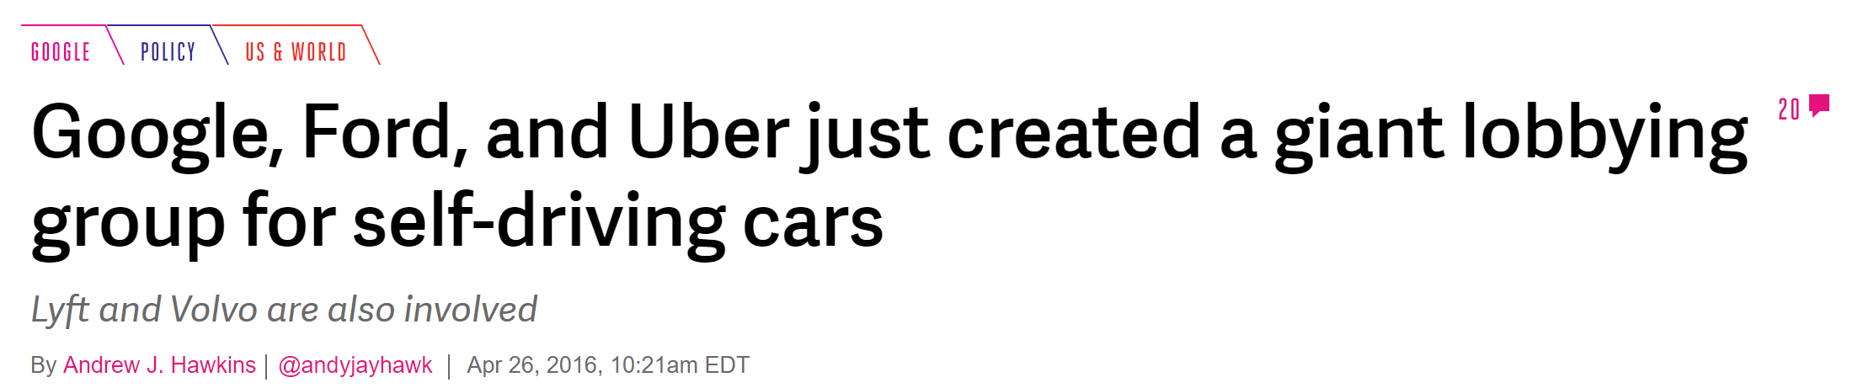
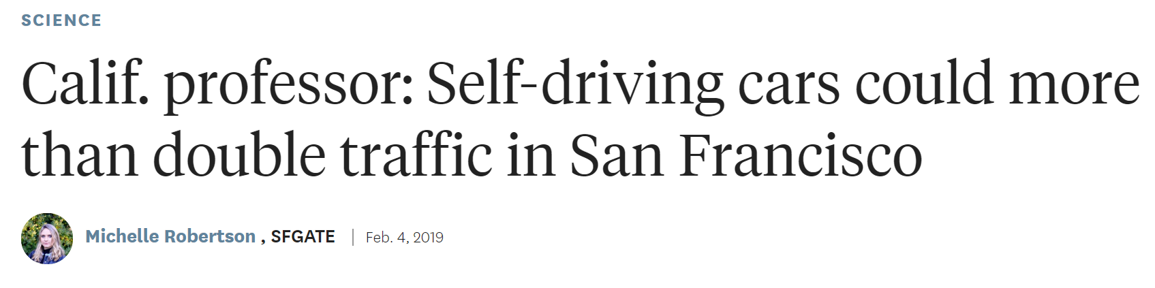
Autonomous Vehicle Fervor
Recent News Headlines
AV START Act: “To support the development of highly automated vehicle
safety technologies, and for other purposes.”
SELF DRIVE Act: “[…] to memorialize the Federal role in ensuring the safety of highly automated vehicles […]”
“State records show four Uber lobbyists met with state representatives on the House version of the bill, HB 311 […]
The Senate bill, SB 932, legalizes not only automated vehicles but also “on-demand autonomous vehicle networks””
https://www.miaminewtimes.com/news/florida-legislature-passes-bill-legalizing-self-driving-uber-cars-11161818 (May, 15th, 2019)

Slide 3
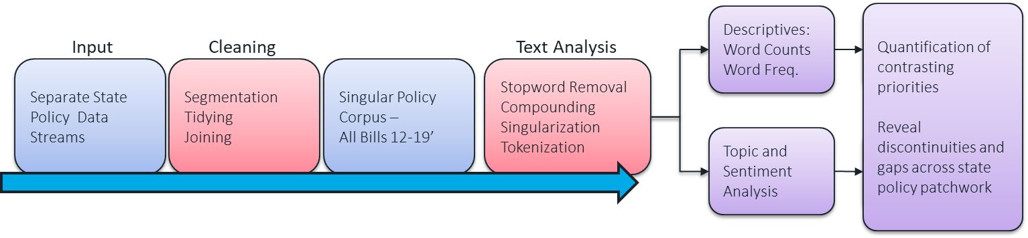
Emphasizing Misalignment
Framework and Workflow
Notes:
Fun Fact: There are 24 different ways that states referred colloquially to AVs. ---- And my program didn’t

Slide 4
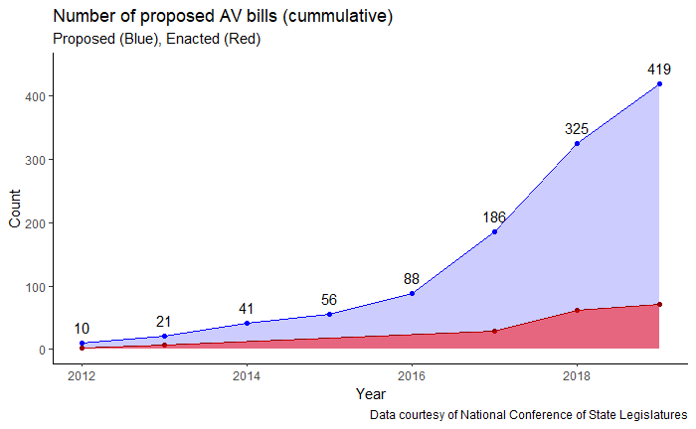
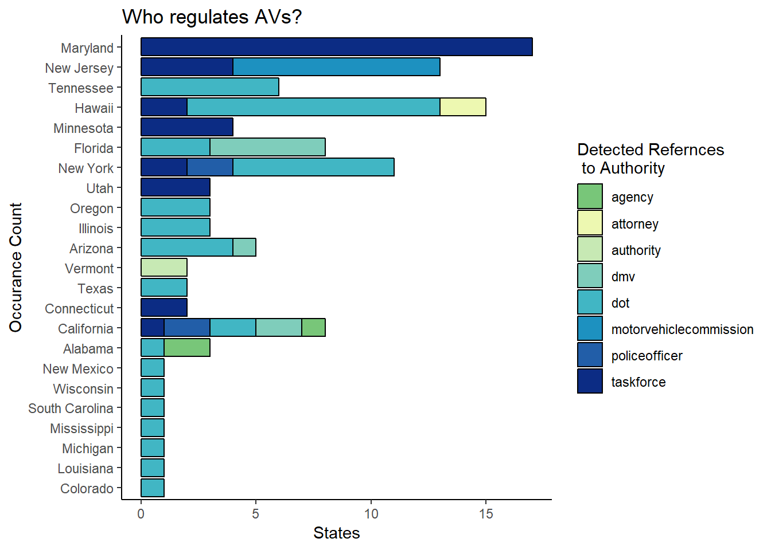
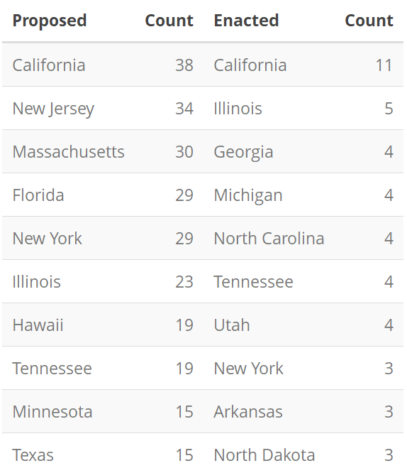
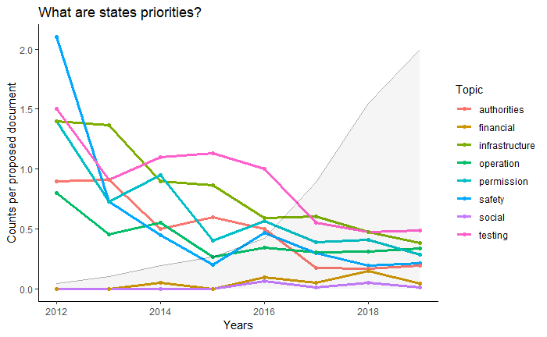
AV policy across all US States (12-19’)

Slide 5
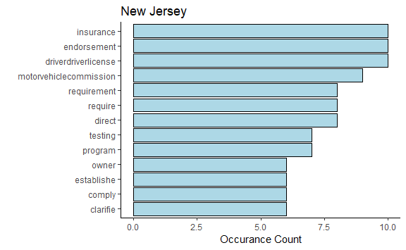
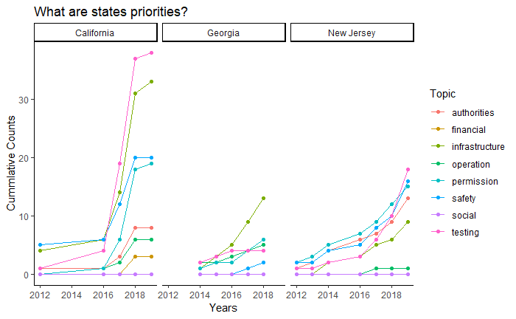
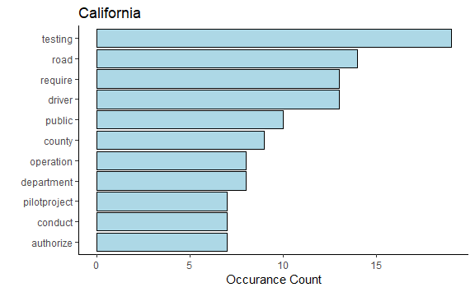
Two State Comparison

Slide 6
Key Takeaways
Unlikely to see any federal leadership regarding AVs anytime soon
Tech and automotive industries will be ambivalent towards regulation
Responsibility of AV policy will fall to states
States will have varying degrees of expertise, incentives, support infrastructure, and attitudes regarding AVs
Will result in a patchwork regulatory environment
Contemporary example is California's Clean Air Act Waiver
There will be (and there already is) different state standards for safety, data privacy, security, and licensing
Key Key Takeaway: Massive misalignment between all players will persist for the foreseeable future

Slide 7
Ghost slides

Slide 8
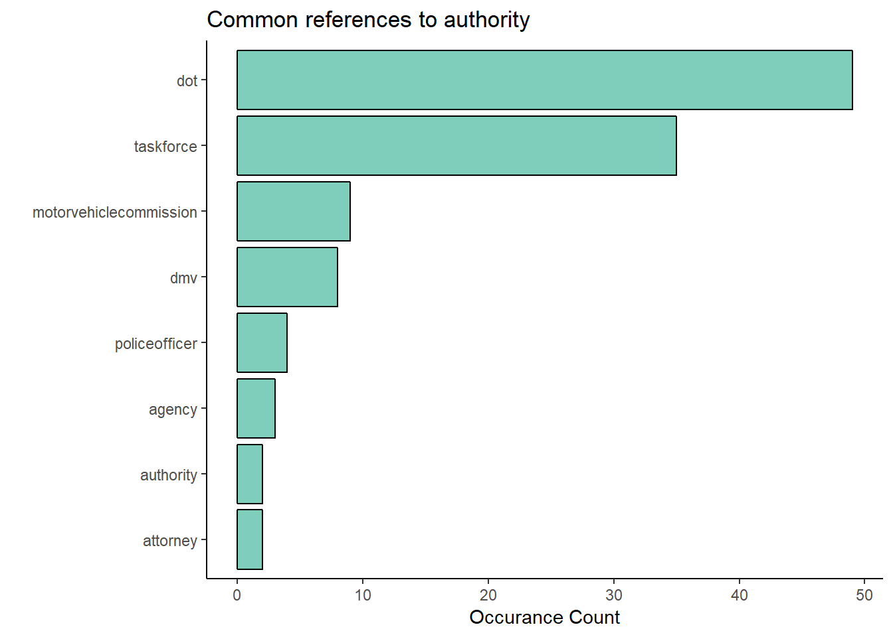
National Snapshot
Inputs
Outputs
2012 Legislation
Problem Statement and Answers
2013 Legislation
External
(Excel) Formatting and Tidying
Text cleaning
Stopword Removal
Punctuation Removal
Tokenization
Word Grouping
Merging
General Descriptive Analysis
2014 Legislation
2015 Legislation
2016 Legislation
Topic and Word Buckets
Topic Idenificaiton
In-Program (R) Subdivision and Tidying
2017 - 2019 Legislation
Descriptives:
Word Counts
Word Freq.
Quantification of contrasting priorities
Reveal discontinuities and gaps across state policy patchwork
Descriptives:
Word Counts
Word Freq.
Input
Cleaning
Text Analysis
Separate State Policy Data Streams
Segmentation Tidying
Joining
Singular Policy Corpus – All Bills 12-19’
Stopword Removal
Compounding
Singularization
Tokenization
Topic and Sentiment Analysis
Descriptives:
Word Counts
Word Freq.

Slide 9
National Snapshot
Inputs
Outputs
Problem Statement and Answers
2012 Legislation
2013 Legislation
External
(Excel) Formatting and Tidying
Text cleaning
Stopword Removal
Punctuation Removal
Tokenization
Word Grouping
Merging
General Descriptive Analysis
2014 Legislation
2015 Legislation
2016 Legislation
Topic and Word Buckets
Topic Idenificaiton
In-Program (R) Subdivision and Tidying
2017 - 2019 Legislation

Slide 10
